Slide 1
Lab 8
Reading Files - April 3, 2024

Slide 2
Agenda
Take up Lab Quizzes 6 & 7
Reading files
Overview
Examples
Complete Lab Quiz 8

Slide 3
But first!!

Slide 4
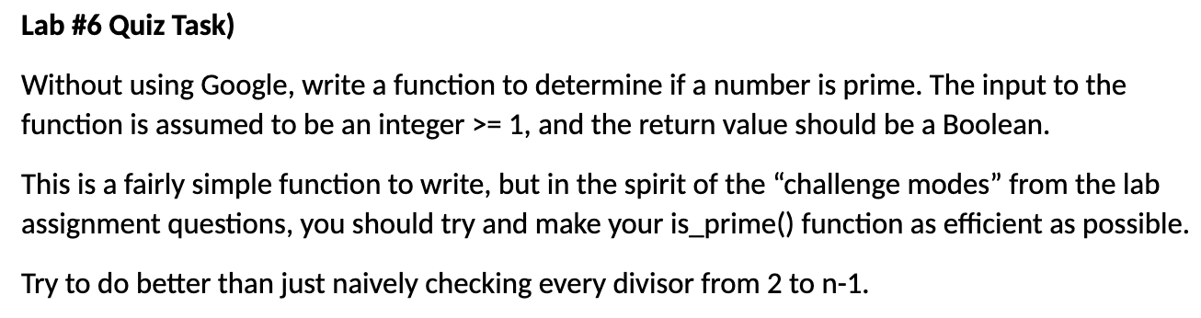

Slide 5
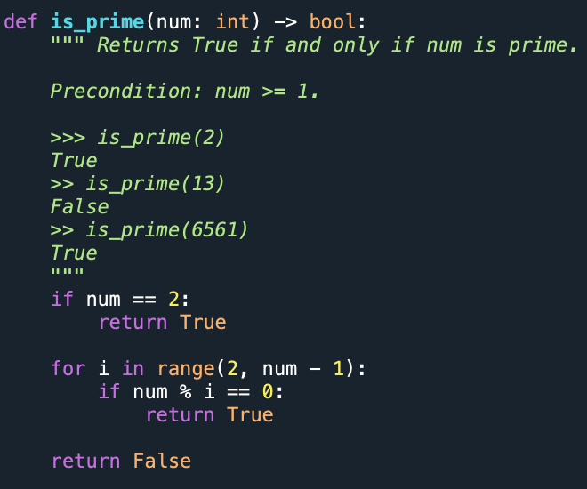
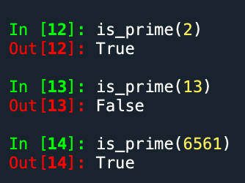

Slide 6
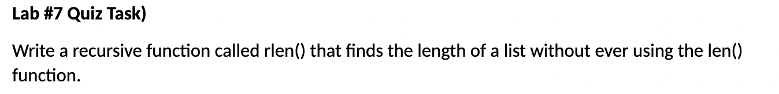
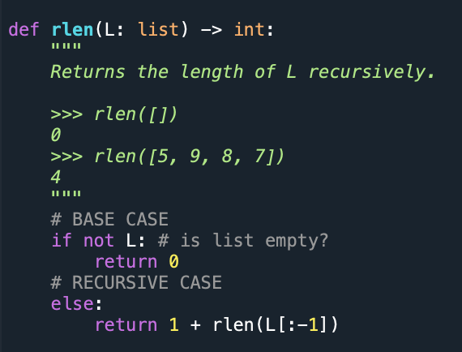
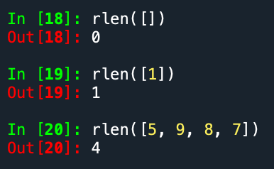

Slide 7
Reading Files

Slide 8
Opening a file
Python provides built-in functions for creating, writing, and reading files.
To be able to interact with or create a file, when need to open it.
Opening a file → Getting a file ready for reading/writing.
The open()function returns a file object and takes in two arguments:
The file name: str
The access mode: str
Governs the type of operations we can do with the opened file
Syntax:
file = open(“file_name”, “access_mode”)

Slide 9
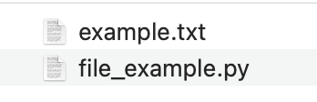
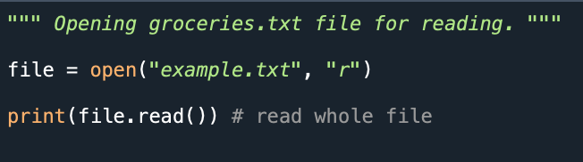

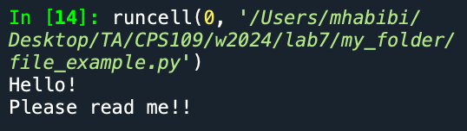
Example: Opening a file for reading
My folder:
file_example.py
examples.txt
Output [from running file_example.py]

Slide 10
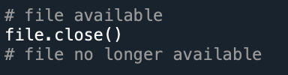
Note: Use close() when finished using a file

Slide 11
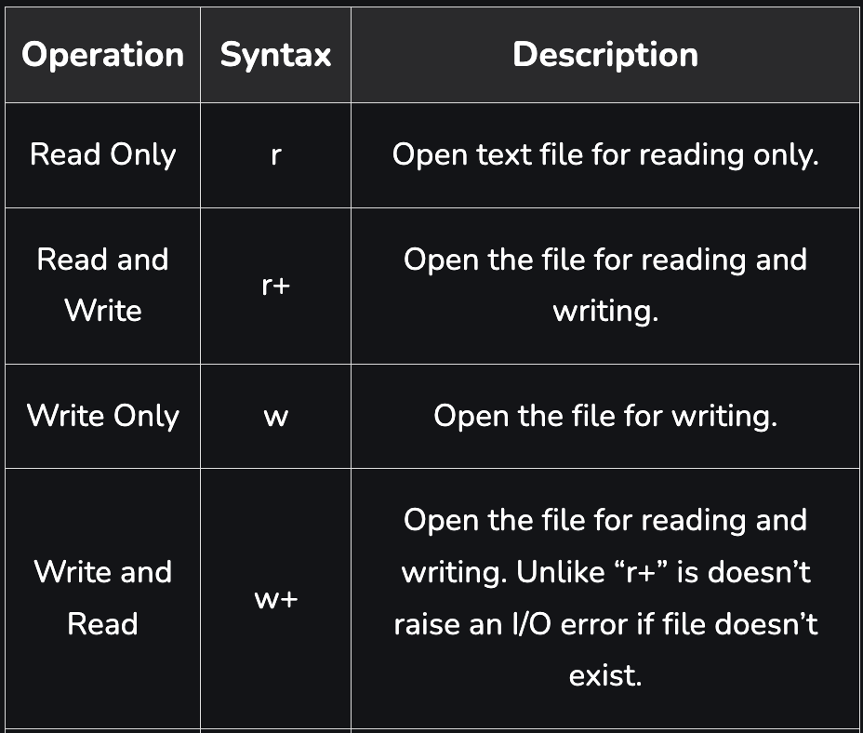
Access Modes
Read only (“r”) access mode allows us to access file reading functions:
Ex. read(), readline(), etc.

Slide 12
Reading Files - Approaches
The readline approach
The for line in file approach
The read approach
The readlines approach

Slide 13
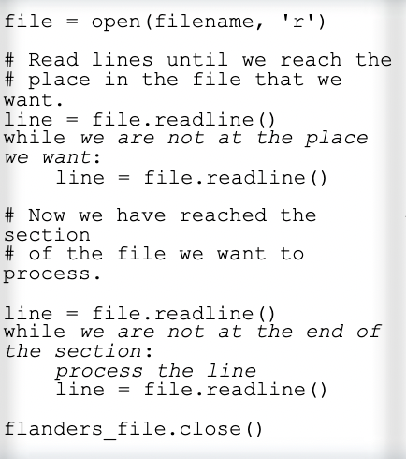
The readline() approach
When to use: When you only want to process parts of a file.

Slide 14
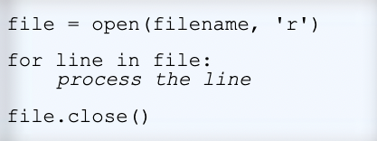
The for line in file approach
When to use: When you want to process every line in a file one at a time.

Slide 15
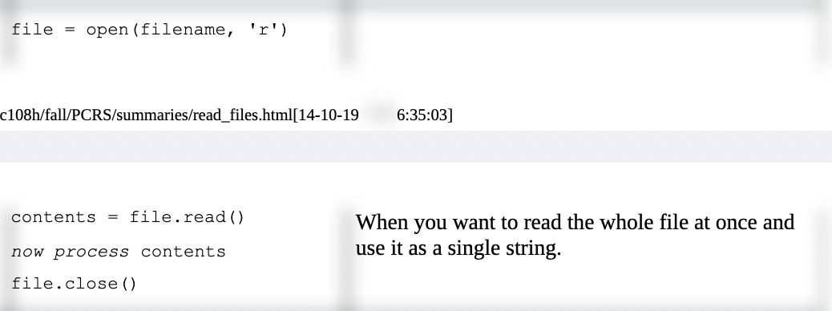
The read() approach
When to use: When you want to read the whole file at once and use it as a single string.

Slide 16
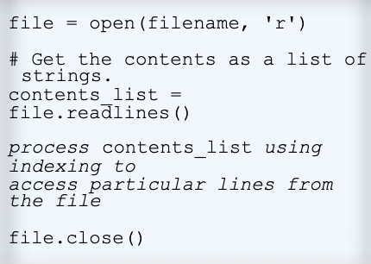
The readlines() approach
Returns the whole file formatted as a list of strings, where each item in list is a string-formatted line in the file.
When to use: When you want to examine each line of a file by index.

